Slide 1

SMART INDIA HACKATHON 2026
TITLE PAGE
Problem Statement ID –
Problem Statement Title-
Theme-
PS Category- Software/Hardware
Team ID-
Team Name (Registered on portal)

Slide 2

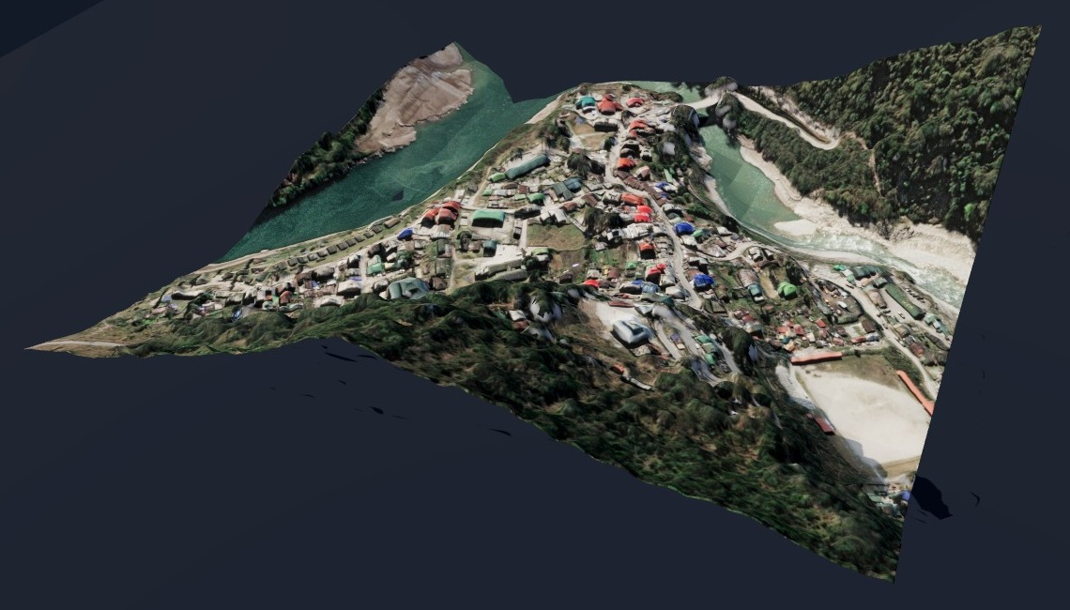
ONE IMAGE → 3D TERRAIN
THE PROBLEM
OUR SOLUTION
▪ India loses about USD 7.4 billion a year to floods alone. [1]
▪ Flood and landslide maps need an elevation model, but today that means LiDAR, stereo or radar: $5k–$100k+ per survey and days of flying. [2]
▪ AI depth models give only relative depth from a photo, not real metres.
▪ One satellite or aerial image in, a metric elevation model out: a DSM GeoTIFF and a 3D scene you can fly through.
▪ Our model reads height above ground in metres straight from the photo; a free 30 m terrain map adds the ground.
▪ GeoTIFF → absolute DSM · PNG/JPG → relative DSM · 3 map points place a plain image.
▪ It checks itself: drop in LiDAR or any reference and see the error map.
Our output: Chungthang, Sikkim, from one WorldView-2 image
4.96 m
26% lower
3.8 m
≈ 7 s
average height error on 40 held-out airborne-LiDAR test tiles
error than RS3DAda, a published height model, on the same tiles
full-DSM error on hilly terrain vs airborne LiDAR (terrain map alone: 5.9 m)
per 600 × 600 m scene on a laptop GPU, fully offline
HOW IT WORKS · innovation: the model predicts metres directly (no relative-depth guessing) and every result can be checked against LiDAR
Image in
GeoTIFF · PNG · JPG · TIFF
Our AI model
heights in metres
+ Terrain map
Copernicus / SRTM
DSM GeoTIFF
QGIS / ArcGIS ready
3D flythrough
+ LiDAR check

Slide 3
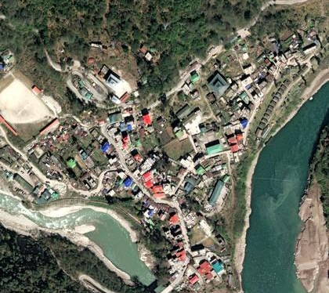
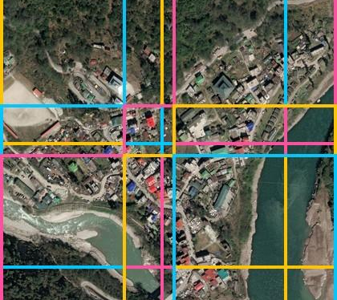
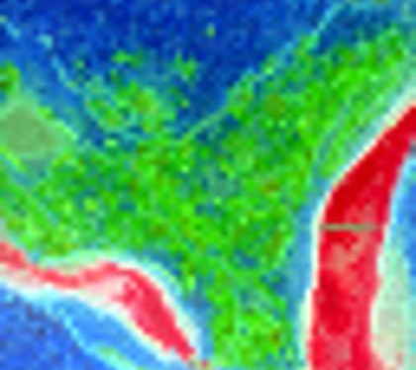
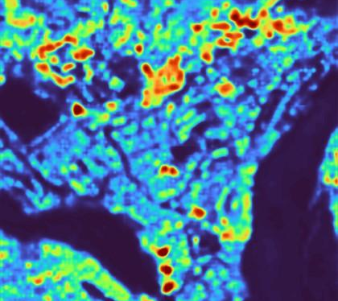
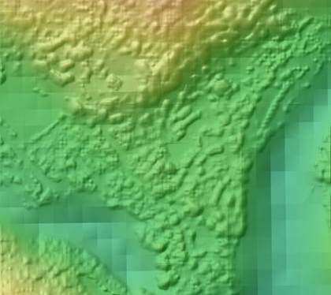
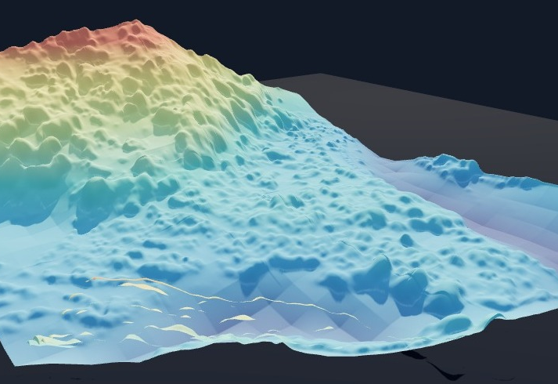
TECHNICAL APPROACH
TECHNOLOGIES
Python
PyTorch
DINOv3-SAT (Meta)
GAMUS dataset
Copernicus GLO-30
Rasterio · GDAL
Three.js · WebGL
USGS 3DEP LiDAR
METHODOLOGY: ONE IMAGE TO 3D (real outputs of our pipeline)
1
2
3
4
5
6
Input image
Split into tiles
What the AI sees
Height above ground
+ terrain = DSM
3D flythrough
WorldView-2, 0.31 m
608 px, 25% overlap
DINOv3-SAT features
our trained head, metres
Copernicus 30 m, EGM2008
Three.js, offline
TRAINING AND VALIDATION
WORKING PROTOTYPE
GAMUS
aerial photos + airborne-LiDAR heights; 480 train · 48 val · 40 test tiles
Model
frozen DINOv3-SAT encoder + our DPT head, Huber loss in metres
Tested
on held-out tiles and 8 USGS LiDAR sites, never on training data
Upload an image, get the DSM, fly through it in 3D and check it against LiDAR, all in the browser, offline.

Slide 4
FEASIBILITY AND VIABILITY
It already works
Accuracy is measured
Cheap to run
Built and tested end to end: image in, DSM GeoTIFF and 3D scene out. 101 automated tests pass.
40 held-out LiDAR tiles and 8 USGS airborne-LiDAR sites, from towns to hills.
Laptop GPU, offline, free data (GAMUS, Copernicus DEM). No survey flights.
Challenge | How we handle it
Tall towers and dense 25 m canopy are under-predicted. | We report it openly (35.9 m error in a downtown); next, more tall-building and forest tiles in training.
Trained on US aerial photos; Indian satellite accuracy not yet measured. | Pixel-size normalisation (tested 0.3–1 m); the built-in reference check scores any ISRO scene with ground truth.
Metric scale from one image is ill-posed. | Model trained on LiDAR metres; terrain from Copernicus or SRTM; map points or a reference raster calibrate.
Angled (oblique) photos show building walls. | We take top-down satellite and aerial imagery, as the problem statement specifies.

Slide 5
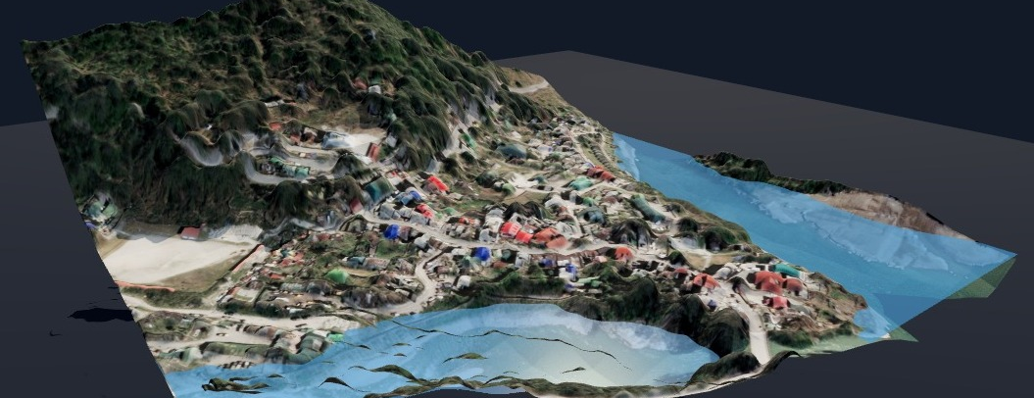
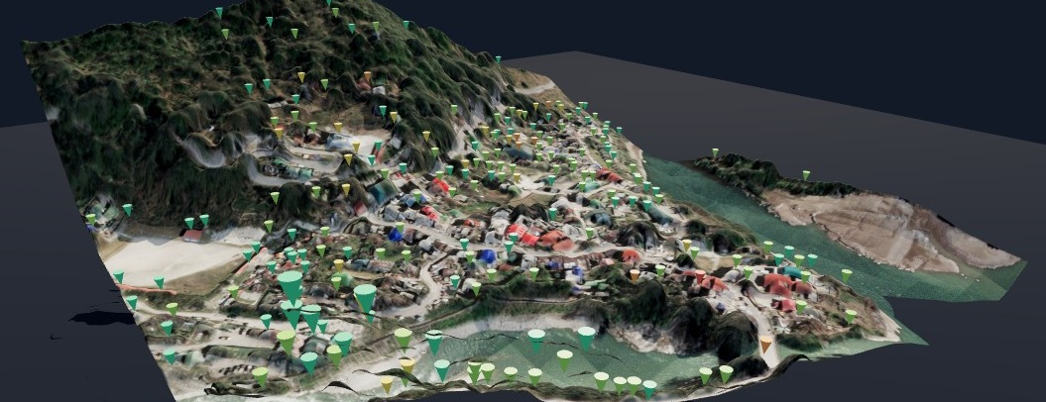
IMPACT AND BENEFITS
WHO IT HELPS
Disaster management
Urban planning
Remote and border areas
Flood and landslide screening from one image. Here, at a 36 m river rise, 12 of 204 buildings are reached.
Building heights and floor estimates, slopes and contours for growth, drainage and rooftop planning.
Terrain where no LiDAR exists, such as Himalayan towns, for relief and mission planning.
BENEFITS
ECONOMIC
No survey flight: uses imagery already collected and a free 30 m terrain map.
SOCIAL
Faster hazard maps for places that have never been surveyed.
ENVIRONMENTAL
No extra aircraft or drone flights.
OPERATIONAL
Offline on a laptop in seconds; standard GeoTIFF for existing GIS tools.
“ParallaX turns images India already collects into measured 3D terrain in seconds, and shows its own error against LiDAR.”

Slide 6
RESEARCH AND REFERENCES
Your Team Name
Details / Links of the reference and research work

